Slide 1
Accessibility Basics
Julie Grundy
@stringy

Slide 2
Assistive Tech

Slide 3
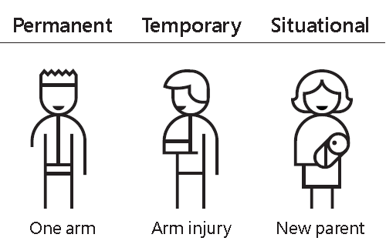
Microsoft’s Inclusive Design Resources https://www.microsoft.com/en-us/design/inclusive

Slide 8
Notes:
Remake this to 16:9

Slide 10
Building

Slide 12
Notes:
REPLACE THIS

Slide 13
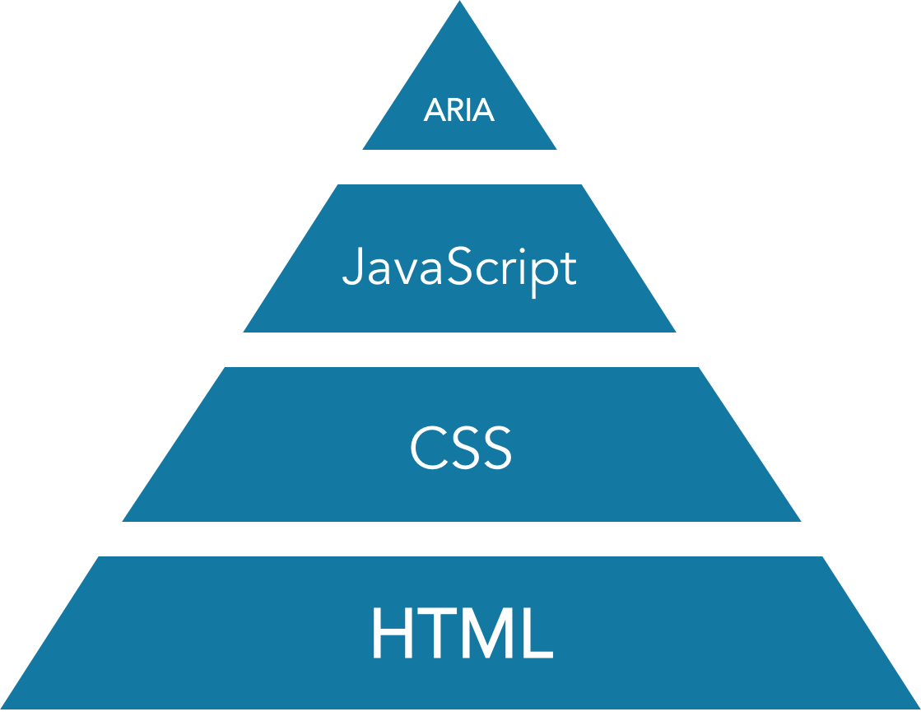

Slide 14
HTML
<div class=“wrapper”>
<div class=“heading heading1”>City Farmers, Belmont</div>
<div class=“summary”>Leading provider of bulk pet and garden supplies. <a href=“www.cityfarmers.com.au/belmont”>Visit Website</a></div>
<div class=“rating-summary”><span>4.5/5 stars</span><span>32 reviews</span><span><a href=“www.google.com/fj5qp23984ht/”>Review on Google</a></span></div>
<div class=“btn”>Open in Google Maps</div>
</div>

Slide 15
HTML - Semantics
<div class=“wrapper”>
<h1>City Farmers, Belmont</h1>
<p>Leading provider of bulk pet and garden supplies. <a href=“www.cityfarmers.com.au/belmont”>Visit Website</a></p>
<ul>
<li>4.5/5 stars</li>
<li>32 reviews</li>
<li><a href=“www.google.com/fj5qp23984ht/”>Review on Google</a></li>
</ul>
<button>Open in Google Maps</button>
</div>

Slide 16
HTML
Mozilla Developer Network’s HTML Reference
https://developer.mozilla.org/en-US/docs/Web/HTML/Reference
Semantic HTML
https://internetingishard.com/html-and-css/semantic-html/

Slide 19
CSS - Hiding
Everyone
Sighted users
nav.offscreen-menu { display: none;
}
.sr-only {
position: absolute;
width: 1px;
height: 1px;
padding: 0;
margin: -1px;
overflow: hidden;
clip: rect(0, 0, 0, 0);
border: 0;
}

Slide 20
CSS
Color Accessibility Workflows, by Geri Coady
https://abookapart.com/products/color-accessibility-workflows
CSS Tricks
https://css-tricks.com/
Smashing Magazine
https://www.smashingmagazine.com/

Slide 21
Notes:
Bootstrap, scroll to modal section, click to open the demo. Markup usually injected at the end of the page.

Slide 22
Notes:
A user who is relying on the keyboard for navigation, maybe through a screenreader, will have to tab through all of this. Bootstrap takes care of this for you. Tabbing forward sends you to the first link in the modal, and clicking the close link sends us back to where we started from. How can we do the same with our content updates? Let’s look at another example.

Slide 23
Javascript
The Accessibility Project
https://a11yproject.com/
Inclusive Design Patterns by Heydon Pickering
https://www.smashingmagazine.com/printed-books/inclusive-front-end-design-patterns/

Slide 26
ARIA
As for JavaScript, plus:
WAI-ARIA Authoring Practices
https://www.w3.org/TR/wai-aria-practices/

Slide 27
Testing

Slide 31
WCAG 2.0
WCAG v2.0
https://www.w3.org/TR/WCAG20/
WebAIM’s plain language version
http://webaim.org/standards/wcag/checklist
v2.1 due mid-2018 – touch, cognitive support
v3.0 (Silver) due in 2021 – VR, games, and more

Slide 32
Notes:
Technically, this is accessible

Slide 34
Thankyou
Slides:
www.juliegrundy.id.au/links/basics.html Julie Grundy
@stringy

